Slide 1

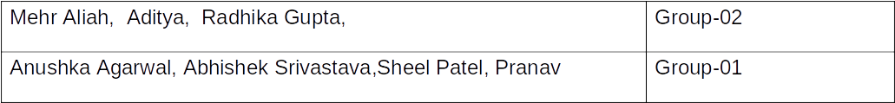
Atal Bihari Vajpayee-
Indian Institute of Information Technology and Management Gwalior
Computer Graphics Lab : 11
Creating a Real Scene
Instructors – Dr. Sunil Kumar
Dept. of Information Technology, ABV-IIITM Gwalior
Teaching Assistants (TAs)

Slide 2
Objective of this lab
To create realistic scenes on a computer screen using OpenGL by modeling objects, applying transformations, and combining graphical elements to reproduce given scenes or design a scene of choice.

Slide 3
Demo Assignment - 01
#include <GL/glut.h>
#include <cmath>
void circle(float y, float r) {
glBegin(GL_TRIANGLE_FAN);
glVertex2f(0, y);
for (int i = 0; i <= 360; i++)
glVertex2f(r * cos(i * 3.14159 / 180),
y + r * sin(i * 3.14159 / 180));
glEnd();
}
void display() {
glClear(GL_COLOR_BUFFER_BIT);
glColor3f(0, 0, 0);
glRectf(-0.3, 0.1, 0.3, 0.9);
// Red, yellow and green lights
glColor3f(1, 0, 0);
circle(0.72, 0.15);
glColor3f(1, 1, 0);
circle(0.50, 0.15);
glColor3f(0, 1, 0);
circle(0.28, 0.15);
glFlush();
}
int main(int argc, char** argv) {
glutInit(&argc, argv);
glutInitDisplayMode(GLUT_SINGLE | GLUT_RGB);
glutInitWindowSize(400, 500);
glutCreateWindow("Traffic Signal");
gluOrtho2D(-1, 1, 0, 1);
glutDisplayFunc(display);
glutMainLoop();
return 0;
}

Slide 4
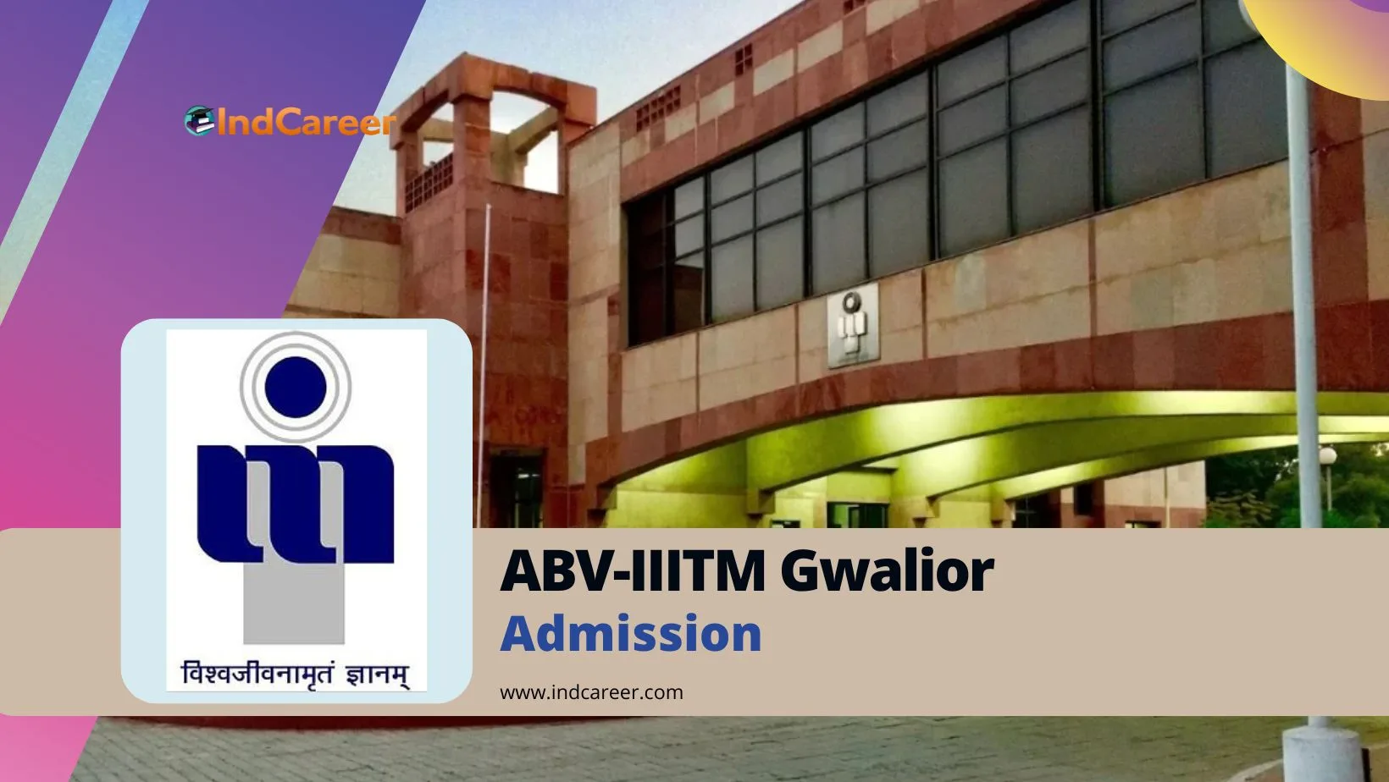
Assignment - 02
Question -02 : Create the scene shown below on computer screen

Slide 5
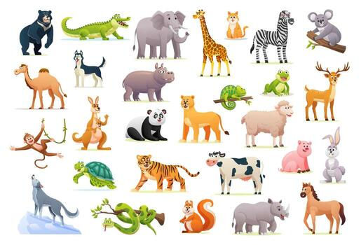
Assignment - 03
Question -03 : Create any one of the following scene on computer screen

Slide 6
Thank you !

